Slide 1

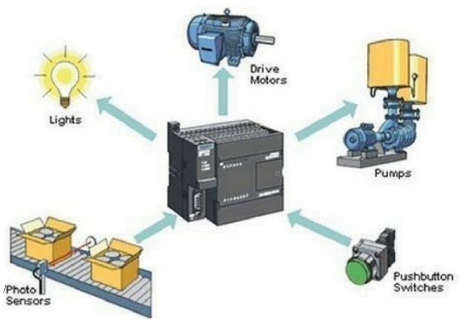
MBEYA UNIVERSITY OF SCIENCE AND TECHNOLOGY COLLEGE OF ENGINEERING AND TECHNOLOGY DEPARTMENT OF MECHANICAL AND INDUSTRIAL ENGINEERING MODULE_ME 6215: Programmable Logical Controller I
COURSE CREDIT: 07
Prepared by;
Dr. Masoud Kamoleka Mlela
BSc. Electromechanical Engineering (UDSM)
MSc, Renewable Energy (UDSM)
PhD, Mechanical Engineering (HEU-CN).
Lecture 3

Slide 2
Introduction to PLC
Programmable logic controller can be defined as a digital electronic device that uses a programmable memory to store instructions and to implement functions such as logic, sequencing, timing, counting and arithmetic in order to control machines and processes.
The term logic is used because the programming is primarily concerned with implementing logic and switching operations
In put devices, e.g. switches, keyboards, actuator and sensor. output devices e.g. motors, being controlled are connected to the PLC and then the controller monitors the inputs and outputs according to this program stored in the PLC by the operator and so control the machine or processes.
Originally they were designed as a replacement for hard-wired relay and timer logic control system

Slide 3
Introduction to PLC (Contd.)
PLCs have the great advantage that it is possible to modify a control system without having to rewire the connections to the input and output devices, the only requirement being that an operator has to key in a different set of instructions.
PLCs are similar to computers but have certain feature which are specific to their use as controller. These are:
They are rugged and designed to withstand vibrations, temperature, humidity and noise
The interfacing for inputs and outputs is inside the controller
They are easily programmed and have an easily understood programming language. Programming is primarily concerned with logic and switching operation

Slide 4
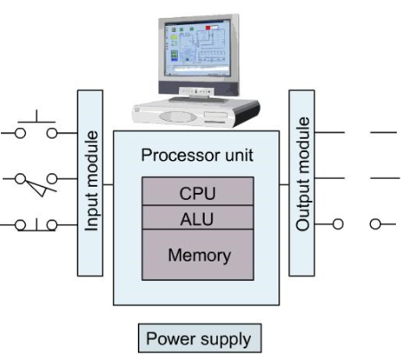
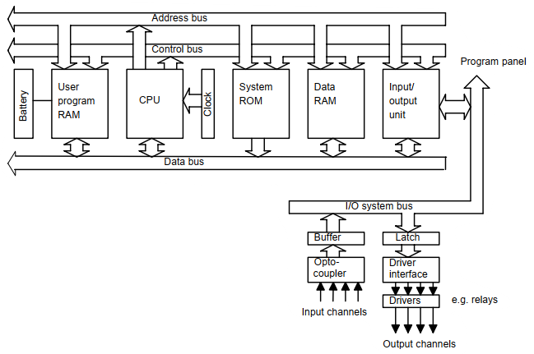
BASIC STRUCTURE
PLC consists of essentially of a Central processing Unit (CPU), Memory, and input/output circuitry.
The CPU controls and processes all the operations within the PLC
It is supplied with the clock with a frequency of typically between 1 and 8MHZ. this frequency determines the operating speed of the PLC and provides the timing and synchronization for all elements in the system
An Arithmetic and logic unit (ALU) which is responsible for data manipulation and carrying out arithmetic operations of addition and subtraction and logic operations of AND, OR, NOT and EXCLUSIVE-OR
The memory, termed as registers, located within the microprocessor and used to store information involved in programs execution
A control unit which is used to control the timing of operations
Fig 1.0 Architecture of PLC

Slide 5
BASIC STRUCTURE
A bus system carries information and data to and from the CPU, memory and input/output unit
The data bus is used to transport a word to or from the CPU and the memory or the input/output interfaces
The address bus carries signals which indicate where data is to be found and so the selection of certain memory locations or input or output ports
The control bus is the means by which signals are sent to synchronize the separate elements

Slide 6
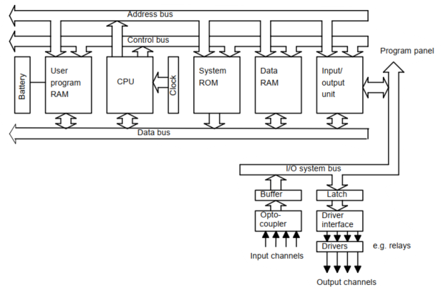
BASIC STRUCTURE
There are several memory elements
a system ROM to give permanent storage for the operating system and fixed data
RAM for the user’s program and
temporary buffer store for the input/output channel

Slide 7
BASIC STRUCTURE
The programs in RAM can be changed by the user, However, to prevent the loss of these programs when the power supply is switched off, a battery is likely to be used in the PLC to maintain the RAM contents for a period of time
After a program has been developed in RAM it may be loaded into an EPROM memory chip and so made permanent

Slide 8
Input/output Processing
The basic form of programming commonly used with PLCs is ladder logic programming. This method resembles a ladder structure, where each "rung" represents a specific logic operation or control sequence.
For example, a rung might specify that the states of inputs, such as switch A and switch B, should be evaluated. If both switches A and B are closed, the output, such as a solenoid, is energized. Ladder logic programming will be explored in greater detail in the next section.

Slide 9
Input/output Processing
The sequence followed by a PLC when carrying out a program can be summarized as
Scan the input associated with one rung of the ladder program
Solve the logic operation involving those inputs
Set/reset the outputs for that rung
Move on to the next rung and repeat operation 1,2,3.
Move on to the next rung and repeat operation 1,2,3.
Move on to the next rung and repeat operation 1,2,3.
And so on until the end of the program
Each rung of the ladder program is thus scanned in turn

Slide 10
Input/output Processing
There are two methods that can be used for input/output processing
Continuous updating
Mass input/output copying

Slide 11
Input/output Processing
Continuous updating
This involve CPU scanning the input channels as they occur in the program instructions
Each input point is examined individually and its effect on the program determined
There will be a built-in delay, typically about 3ms, when each input is examined in order to ensure that only valid input signals are read by the microprocessor
This delay enables the microprocessor to avoid counting an input signals twice, or more frequently, if there is contact bounce at a switch.
A number of inputs may have to be scanned, each with a 3ms delay, before the program has the instruction for a logic operation to be executed and an output to occur. The outputs are latched so that they retain their status until the next updating

Slide 12
Input/output Processing
Mass input/output copying
Because, with continuous updating, there has to be a 3ms delay on each input, the time taken to examine several hundred input/output points can became comparatively long
To allow a more rapid execution of a program, a specific area of RAM is used as a buffer store between the control logic and the input/output unit.

Slide 13
PLC Programming Languages
According to IEC 61131-3, the main PLC programming languages are:
Ladder Logic (LD): Graphical language resembling electrical relay logic diagrams.
Function Block Diagram (FBD)
Structured Text (ST)
Instruction List (IL)
Sequential Function Chart (SFC)

Slide 14
PLC Programming
PLC programming based on the use of ladder diagrams involves writing a program in a similar manner to drawing a switching circuit. The ladder diagram consists of two vertical lines representing the power rails. They are called “ladder” diagrams because they resemble a ladder, and as many “ rungs” (horizontal lines)

Slide 15
PLC Programming
In the drawing the circuit line for a rungs, inputs must always precede outputs and there must be at least one output on each line. Each rung must start with an input or a series of inputs and end with an output.
The inputs and outputs are numbered, the notation used depending on the manufacturer, e.g. the Mitsubishi F series of PLCs precedes input elements by an X and output elements by a Y and uses the following numbers
In put X400 - 407, 410 - 413
X500 - 507, 510 - 513
(24 possible inputs)
Outputs Y430 - 437
Y530 - 537
(16 possible outputs)

Slide 16

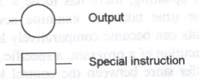

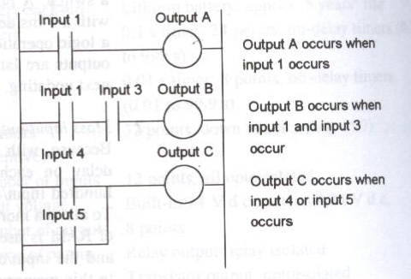
PLC Programming
Ladder symbols
Fig 1.1 Ladder Logic diagram

Slide 17
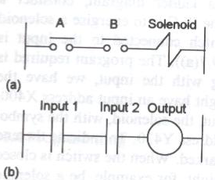
PLC Programming
Logic functions
The logic functions can be obtained by combinations of switches and the following shows how we can write ladder programs for such combinations
AND logic condition
Figure 1.2(a) shows a situation where a coil is not energized unless two, normally open, switches are both closed. Switch A and switch B have both to be closed, which thus gives an AND logic situation.
The ladder diagram starts with [ ], labeled Input 1, to represent switch A and in series with it [ ], labeled Input 2, to present switch B. The line then terminates with Ο to present the output. Figure 1.2(b) shows the line.
Fig 1.2 An AND system

Slide 18
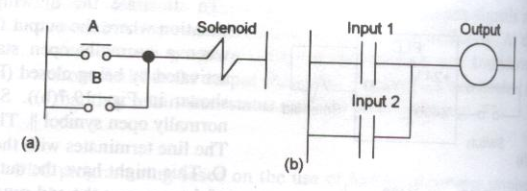
PLC Programming
OR Logic Condition
Figure 1.3(a) illustrates:
A coil that is not energized until either Switch A or Switch B is closed.
This represents an OR logic condition: situation where a coil is not energized until either, normally open, switch A or B is closed.
The situation is an OR logic gate.
The ladder diagram starts with ⎢⎢, labeled Input 1, to represent switch A and in parallel with it ⎢⎢, labeled Input 2, to represent switch B. The line then terminates with Ο to present the output. Figure 1.3(b) shows the line.
Fig. 1.3 An OR systems

Slide 19
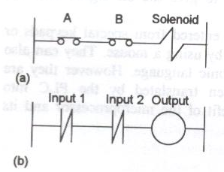
PLC Programming
NOR Logic Condition
Figure 1.4 Illustrate:
The output is energized only when neither Switch A nor Switch B is activated
NOT (A OR B) → Output is on only when both A and B are off.
The ladder program shows Input 1 in parallel with Input 2, with both being represented by normally closed contacts.
Fig. 1.4: A NOR system

Slide 20
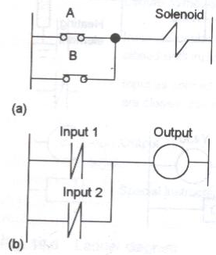
PLC Programming
NAND
Figure 1.5 shows a NAND gate. There is no output when both A and B have an input. Thus for the ladder program line to obtain an output we require no inputs to Input 1 and to Input 2.
Fig. 1.5 A NAND system

Slide 21
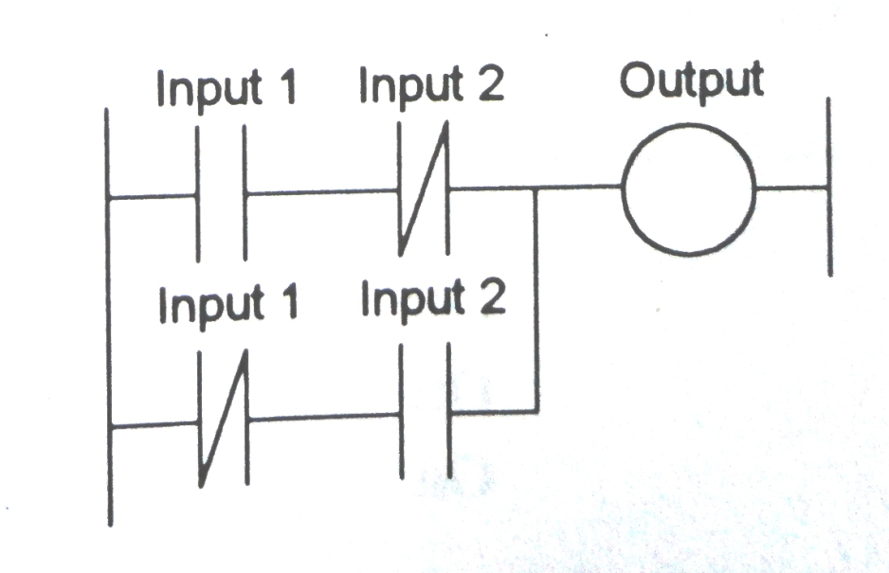
PLC Programming
EXCLUSIVE-OR (XOR)
Figure 1.6 shows how we can draw the ladder program line for an XOR gate, there being no output when there is no input to Input 1 and Input 2 and when there is an input to both Input 1 and Input 2. Note that we have represented each input by two sets of contacts, one normally open and one normally closed.
Explanation
If both inputs are OFF: Both branches are open (no current), output is OFF.
If Input 1 ON, Input 2 OFF: First branch is closed, output is ON.
If Input 1 OFF, Input 2 ON: Second branch is closed, output is ON.
If both inputs are ON: Both branches are open (NC contacts break the circuit), output is OFF.
Fig 1.6: an XOR system

Slide 22
PLC Programming
Each horizontal rung on the ladder in a ladder program represents a line in the program and entire ladder gives the complete program in ‘ladder language’.
The programmer can enter the program into the PLC using a keyboard with the graphic symbols for the ladder elements, or using a computer screen and mouse to select symbols, and the program panel or computer then translates these symbols into machine language that can be stored in the PLC memory.

Slide 23
PLC Programming
Mnemonics
There is an alternative way of entering a program and that is to translate the ladder program into mnemonics, each code corresponding to a ladder element, and then enter these into the programming panel or computer. These are then translated into machine language. The mnemonics used by different PLC manufactures differ.

Slide 24
PLC Programming
For the Mitsubishi F series PLCs, mnemonics used are:
LD Start a rung with an open contact.
OUT An output.
AND A series element and so an AND logic instruction.
OR Parallel elements and so an OR logic instruction.
I A NOT logic instruction
…I Used in conjunction with other instruction to indicate the inverse.
ORI An OR NOT logic function.
ANI An AND NOT logic function.

Slide 25
PLC Programming
For the Mitsubishi F series PLCs, mnemonics used are:
LDI Start a rung with a closed contact.
ANB AND used with two sub circuits.
ORB OR used with two sub circuits.
RST Reset shift register/counter.
SHF Shift.
K Insert a constant.
END End ladder.

Slide 26
PLC Programming
In examples discussed in the rest of this chapter, where general descriptions are not used, the Mitsubishi mnemonics will be used. However, those used by other manufacturers do not differ widely from these and principles involved in their use are the same.

Slide 27
PLC Programming
For example, for OMRON PLCs the codes used are
LD Start a rung with an open contact.
OUT An output.
TIM A timer output.
CNT A counter output.
AND A series element and so an AND logic instruction.
OR Parallel elements and so an OR logic instruction.
NOT A NOT logic instruction.

Slide 28
PLC Programming
For example, for OMRON PLCs the codes used are
…NOT Used in conjunction with other instructions to indicate the inverse.
OR NOT An OR NOT logic function.
AND NOT An AND NOT logic function.
LD NOT Start a rung with a closed contact.
AND LD AND used with two subcircuits.
OR LD OR used with two subcircuit.
# insert constant.
END End ladder

Slide 29
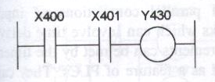
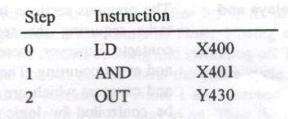
PLC Programming
The following shows how individual rungs on a ladder are entered. Using the Mitsubishi mnemonics, the AND gate shown in Fig. 1.7 would be entered as:
Fig 1.7 An AND system

Slide 30
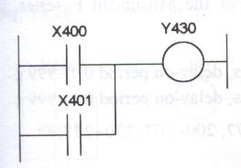
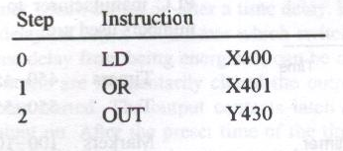
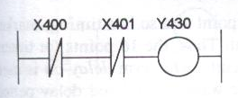
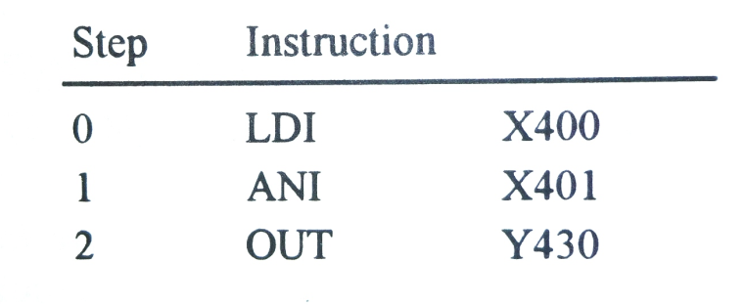
PLC Programming
The OR gate shown in Fig. 1.8 would be entered as
The NOR gate shown in Fig. 1.9 would be entered as
Fig 1.8 An OR system
Fig. 1.9 An NOR

Slide 31
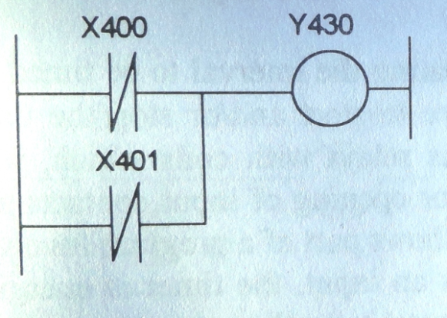
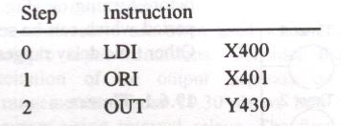
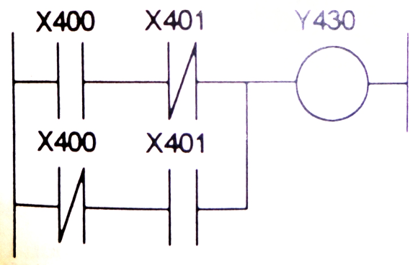
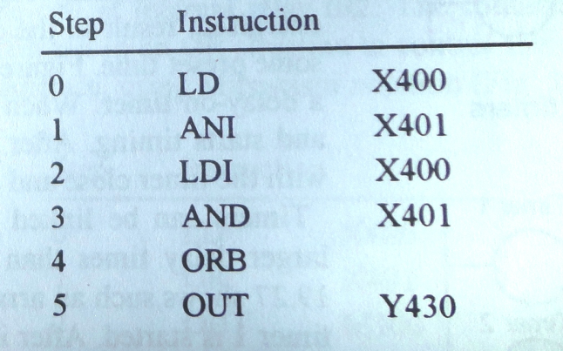
PLC Programming
The NAND gate shown in Fig. 1.10 would be entered as
The XOR gate shown in Fig. 1.11 would be entered as
Fig. 1.10 A NAND system
Fig. 1.11 An XOR system

Slide 32
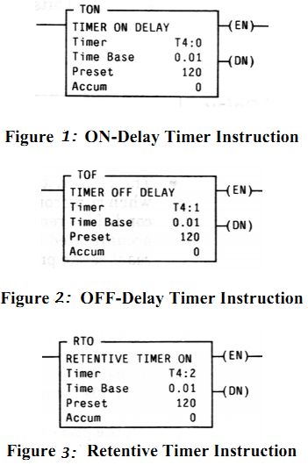
Timers and Counters
Three types of timers are used in PLC ladder logic programs.
ON-DELAY timers
OFF-DELAY timers, and
RETENTIVE timers
Fig show the timer
instructions used
in the Allen-Bradley PLC.

Slide 33
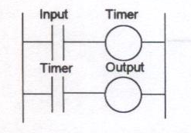
Timers
A timer circuit is specified by starting the interval to be timed and the conditions or events that are to start and/or stop the timer. They are commonly regarded as relays with coil which, when energized, result in the closing or opening of input contacts after some preset time. Figure 1.12 shows part of a program involving a delay-on timer
when there is an input, the timer is energized and starts timing
After some preset time, the contacts associated with the timer close and the output occurs
Fig. 1.12 Timer

Slide 34
Timers
When Programming a timer instruction, the programmer must specify the
The Timer address
The Time Base, and
The Preset Value
The format of the Timer address is T4: N, where N is a positive integer, each timer instruction should have a unique that distinguishes its timer instruction from other timer instructions

Slide 35
Timers
The Time Base value is an interval that the timer is going to use. This value can be set to 1 second, 0.01 second, or 0.001 second
Preset value specifies how many intervals a timer should count before timing is complete, also known as “done”
A timer’s setting Time equals its Preset value multiplied by its Time base

Slide 36
Timers
For Example, if the Time Base is 0.01 and preset is 500, the timer’s setting time is 500x0.01 second=5 seconds. That means this timer will be done 5seconds after the timer instruction is enabled.
A timer instruction must be located next to the right rail in a rung.
An ON-delay timer is enabled when its rung is true.
A rung is true when there is at least one path made by instructions that are true from the left rail to the timer instruction.

Slide 37
Timers
An OFF-delay timer is enabled when its rung is false. When the timer is enabled, its Accumulate value shows how many Time Base intervals have elapsed since the timer was activated.
A timer is done when its Accumulate reaches its Preset value
When an ON-delay timer or an OFF-delay timer is timing, its rung condition changes, i.e. a rung changes from true to false for an ON-delay timer or a rung changes from false to true for an OFF-delay timer, will cause the timer to stop and its Accumulate value to be reset to zero.

Slide 38
Timers
A retentive timer works like an ON-delay timer with one difference. That is, when its rung condition changes from true to false, the timer simply stops timing, but its Accumulate value is not reset zero. When its rung condition goes from false to true again, the retentive timer’s Accumulate value counts up from where it stopped the last time.
To reset a retentive timer’s, Accumulate value to zero, a reset instruction with the same timer address must be used.

Slide 39
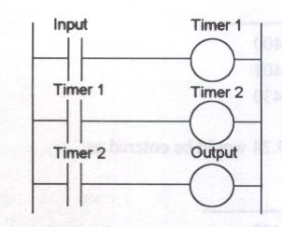
Timers
Timers can be linked together; the term is cascaded, to give larger delay times than is possible with just one timer. Figure 1.13 shows such arrangement.
When the input contacts close, timer 1 is started. After its time delay, its contacts close and timer 2 is started. After its time delay, its contacts close and there is an output.
Fig. 1.13 Cascaded timer

Slide 40
Timers and Counters
Counters
Counters are used when there is a need to count a specific number of contacts operations. eg where the items pass along a conveyer into boxes and when the specific number of items has passed into a box the next item is diverted into another box.
Counter circuits are supplied as internal feature of PLC’s
In most cases the counter operates as a down-counter, this means that the counter counts down from the preset value to zero, i.e events are subtracted from the set value, when zero is reached the counter contact changes state.
An up-counter would count up to the preset value, i.e events are added until the number reaches the set value. When the set value is reached the counter’s contact changes state.

Slide 41
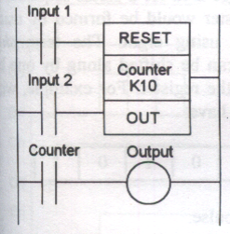
Counters
Fig 1.15(a) below shows a basic counting program. In the ladder diagram the counter is presented by a rectangle spanning two lines.
One line is the RESET which is used to reset the counter
The other line is the OUT line and the K10 indicates that the counter contact will change state on the 10th pulse.
Fig 1.15 (a) Counter

Slide 42
Counters
When the contacts of input 1 momentarily close the counter is reset to the set value.
The counter will then count the number of pulses resulting from the contacts of input 2 closing and opening
When this reaches the set value, in this case 10, the counter contact closes
Thus output is switched on after 10 pulses have been from input 2
If the contacts of input 1 are momentarily closed any time during the count, the counter will reset to 10

Slide 43
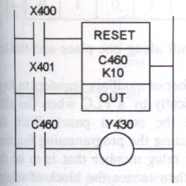
Counters
The instruction sequence using Mitsubishi Notation figure 1.15 (b) is
Step Instruction
0 LD X400
1 RST C460
2 LD X401
3 OUT C460
4 K 10
5 LD C460
6 OUT Y430
Fig 1.15 (b) Counter

Slide 44
Questions

